Slide 1





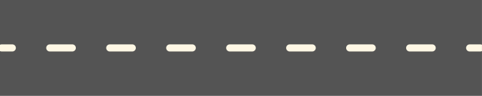
Zomato Order Analysis
Presented by: Keya Jethwa

Slide 2



TOPICS
1
Most Popular Restaurant Type by Rates.
4
Average Booked Table per Order by Count.
2
Customer Votes by Location.
5
Highest Rated Order Mode: Online vs Offline
3
Majority Ratings for Restaurants
6
Restaurant Location with Most Offline Orders. .

Slide 3
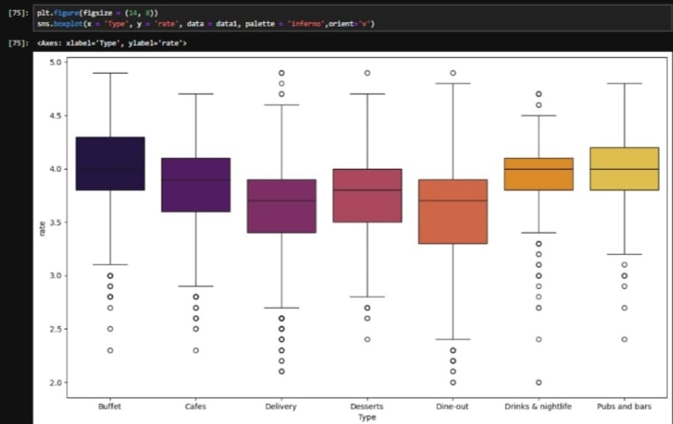
1
Most Popular Restaurant by
Rates.

Slide 4
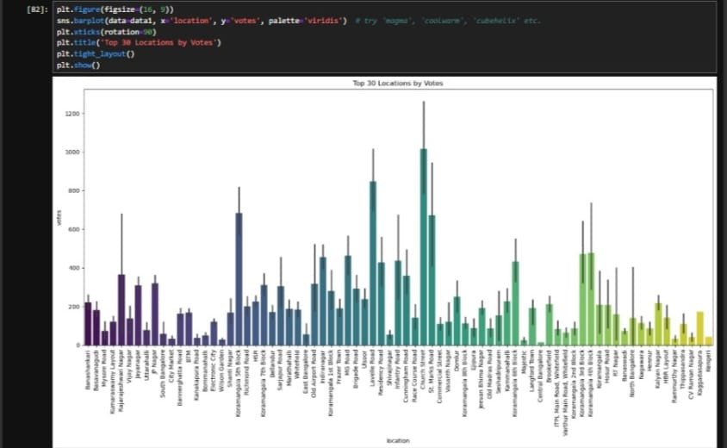
2
Top 10 Locations by Votes.

Slide 5
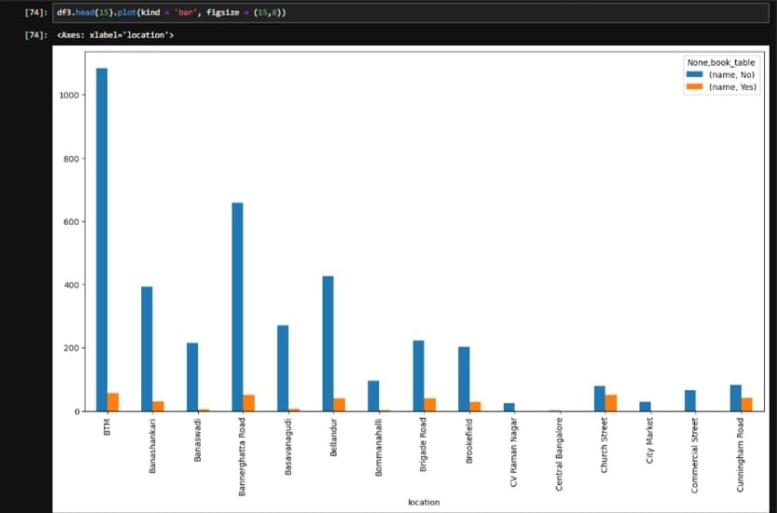
3
Majority Ratings for Restaurants by Book Table

Slide 6
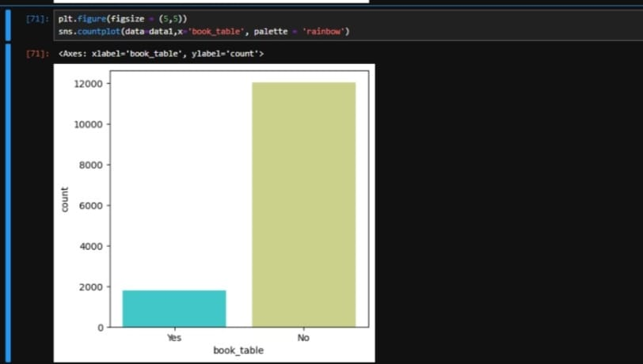
4
Most Booked Table by Count.

Slide 7
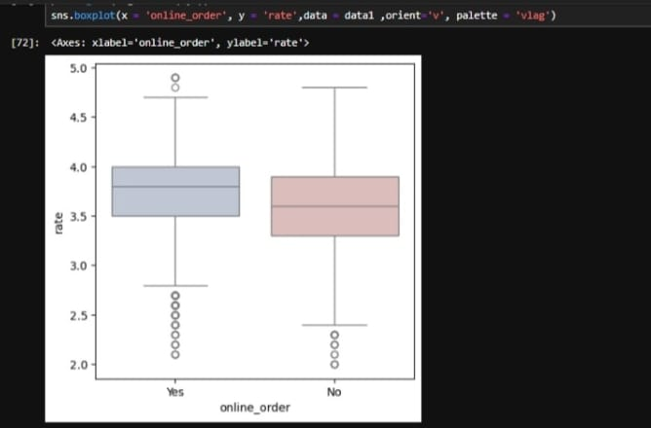
5
Most Order Restaurant according to Rates.

Slide 8
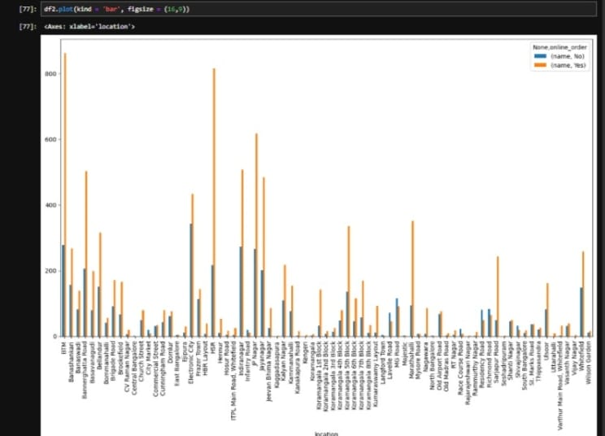
6
Restaurant Location with Most Online Orders.

Slide 9
6
Conclusion.
Top locations like Koramangala and Indiranagar have the highest customer engagement.
Online ordering boosts restaurant popularity and slightly improves ratings.
Table booking is less common but leads to higher-rated customer experiences.
Customers prefer convenience and premium services while choosing restaurants.

Slide 10





Thank you for Your Time!

